Slide 1
Optical Fibre networks 3/4 Network topologies
02 dec 2024
Paul JOLIVET

Slide 2
Optical Fibre Networks : Course general objective
Get a panorama of Optical Fibre and networks
Optical Fibre characteristics and advantages
Technologies around Optical Fibre
Other components of optical fibre networks
Understand How to design high rates optical fibre networks
Existing architecture of Optical Fibre networks (FTTH, FTTA, FTTO…)
Designing a network
Deployment constraints
Understand High rate networks trends to future
Notes:
Pour reference : https://www.researchgate.net/publication/305181019_Technologie_WDM_en_telecoms_optiques_avancees/link/57842b1208ae37d3af6c1685/download

Slide 3
Optical Fibre Networks : Course 3/4 programme
1. Topologies for Fibre network
The requirement, the constraints
Applicable solutions
2. Submarine/Intercontinental
Use cases : typically securing signal
Principle and Technical solutions
3. FTTH
GPON architecture
Equipments
Technical solutions (coupling)
4. FTTA
Evolutive architecture
Urban areas and loop architecture
Countryside and logical loops
Equipments

Slide 4
Network topologies

Slide 5

Choosing a network topology
The need
High rate transfers (but how much?)
Security
Reliability
Trafic continuity whatever is broken
High rate with limited loss
Latency (for accessing services)
Distance/Coverage
Solutions
P2P, dark fibre allocation
Tree
Loops

Slide 6
Network access through telecommunication networks

Slide 7
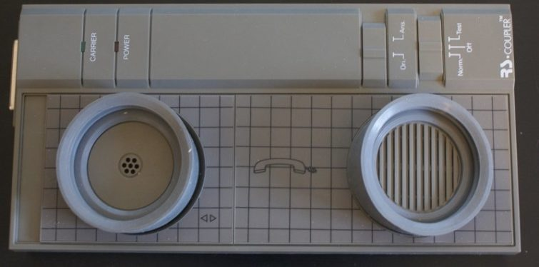
Network/Internet Acces
Mean/resource giving an user the capability to access network services (Internet, Intranet, service plateforms)
Accès mobile :
1G/2G/3G/4G/5G
Wimax, etc.
Accès fixe :
RTC, RNIS
xDSL
DOCSIS
FTTH/GPON
Le Modem acoustique
Vitesse théorique de 300 bauds (~300bps)

Slide 8
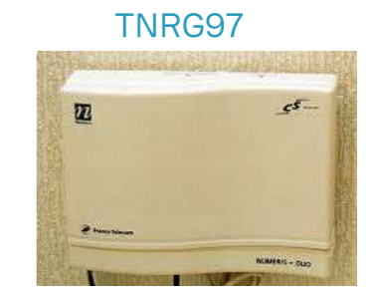
A bit of history
RTC/PSTN : local phone loop + phone call
Modem dialling a number related to a NAS (Network Access Server)
The communication is a phone call
Baud rate limited to modem capability (V.92 ➔ 56kbps)
RNIS/ISDN :
Digitalizing (copper) local loop
2x64kbps + 16kbps (2B+D)
E1/T1 :
2Mbps and more
used in preference to connect central offices together
xDSL : Based on the copper pair but not the telephone network itself
DSLAM
Several types (ADSL,VDSL, SDSL, etc.)

Slide 9

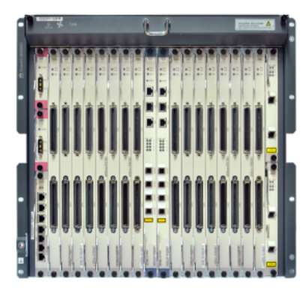


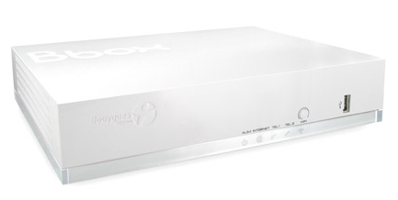
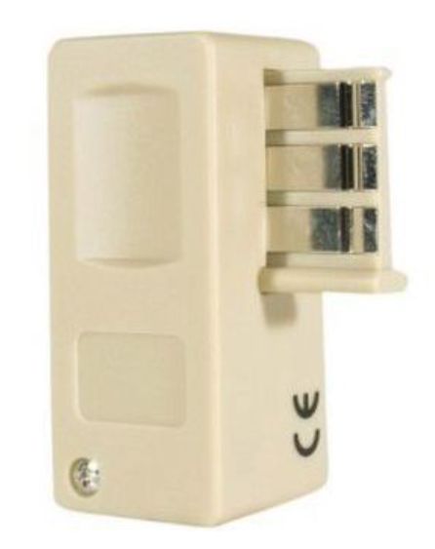
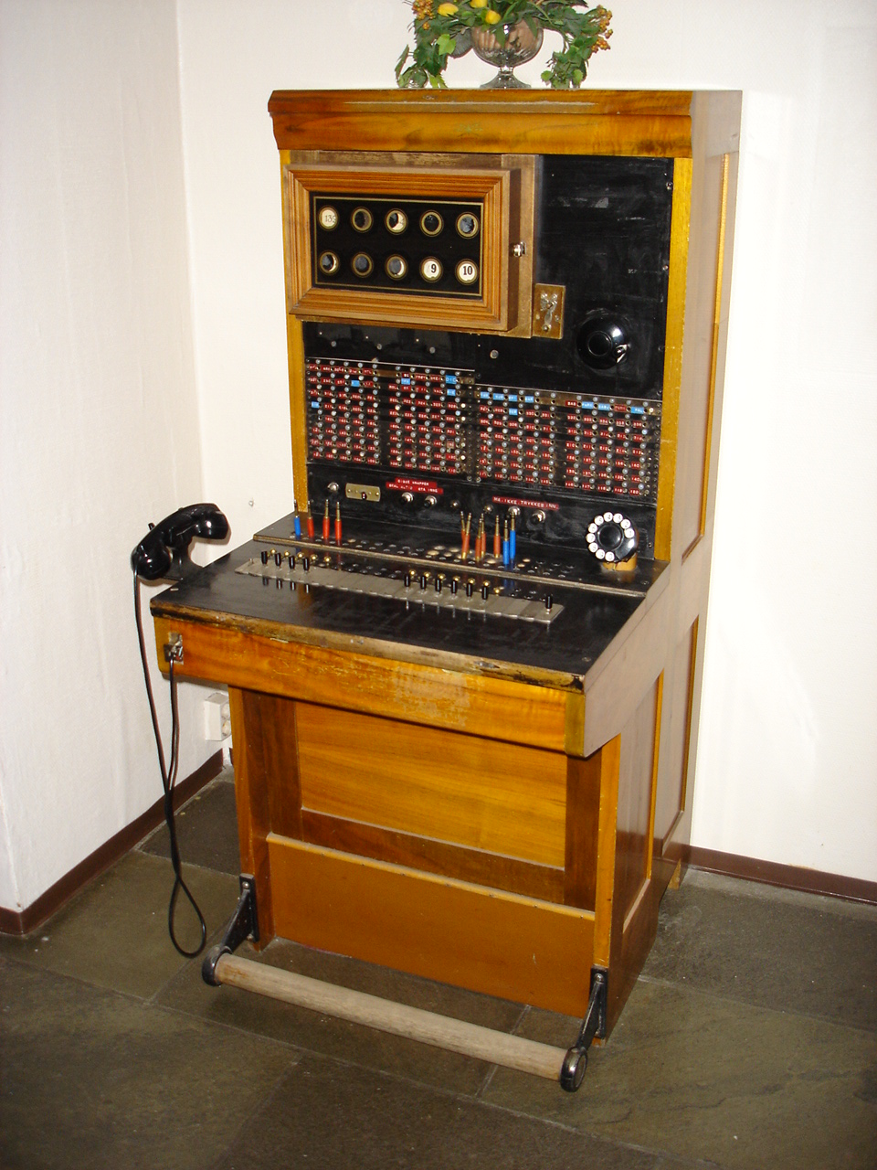



Network access using copper lines
Home
Central Office
@
Modem
56k
RTC
NAS

Slide 10
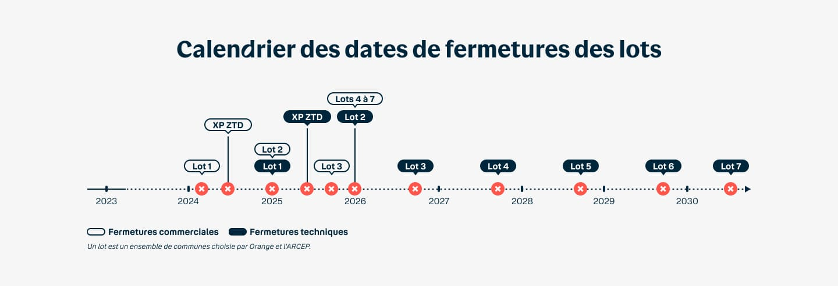
Towards the end of copper lines
Notes:
Gain pour Bouygues Télécom : réduction de l’OPEX
Avantages en général : plus d’entretien du cuivre, libération d’espace (NRA, génie civil)

Slide 11
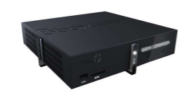
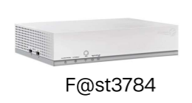
Using coaxial link for the access
DOCSIS (Data Over Cable Service Interface Specification)
2 box chez Bouygues Telecom :
- OB1-C (samsung)
- GALGAL 3784B (SAGEM)
Hybrid Fibre Coaxial network
eCMTS :
~OLT +
~ONT/CMTS
modem
HFC
CMTS
modem
modem
Notes:
E : extended
CMTS + eCMTS (en vrai OLT + ONT/CMTS)

Slide 12
Using coaxial link for the access
DOCSIS | Année | Débit | Apports | QAM
1.0 | 1997 | 5/40 Mbps | TDMA | 16
1.1 | 1999 | 10/40 Mbps | TDMA | 16
2.0 | 2002 | 30/40Mbps | +S-CDMA | 64
3.0 | 2006 | 30/1000Mbps | +S-CDMA / IPv6 | 128/256
3.1 | 2013 | 2/10Gbps | +OFDM/OFDMA | 4096
4.0 | 2017 | 10/10Gbps - 40/40 (10/6 en pratique) | +OFDMA+ | 8192
DOCSIS® 4.0 Technology - CableLabs

Slide 13



FTTx, access on optical fibre
FTTN
FTTdP
FTTH
FTTLA / FTTB
FTTC
FTTCab
FTTO
FTTA
And also : FTTS (street), FTTN (Neighbourhood), FTTE (Entreprise), …
FTTR (Room), a chinese manufacturer on the project. The principle is to use optical fibre within the local network to enable very high speed connection.
Notes:
FTTC : Fiber to the Curb ➔ PC/DSLAM ou coax
FTTN : ➔ SR / DSLAM (ou coax ?) – monté en débit
FTTB = FTTLA intérieur - coax
Revoir les définitions :

Slide 14
FTTH network architecture

Slide 15
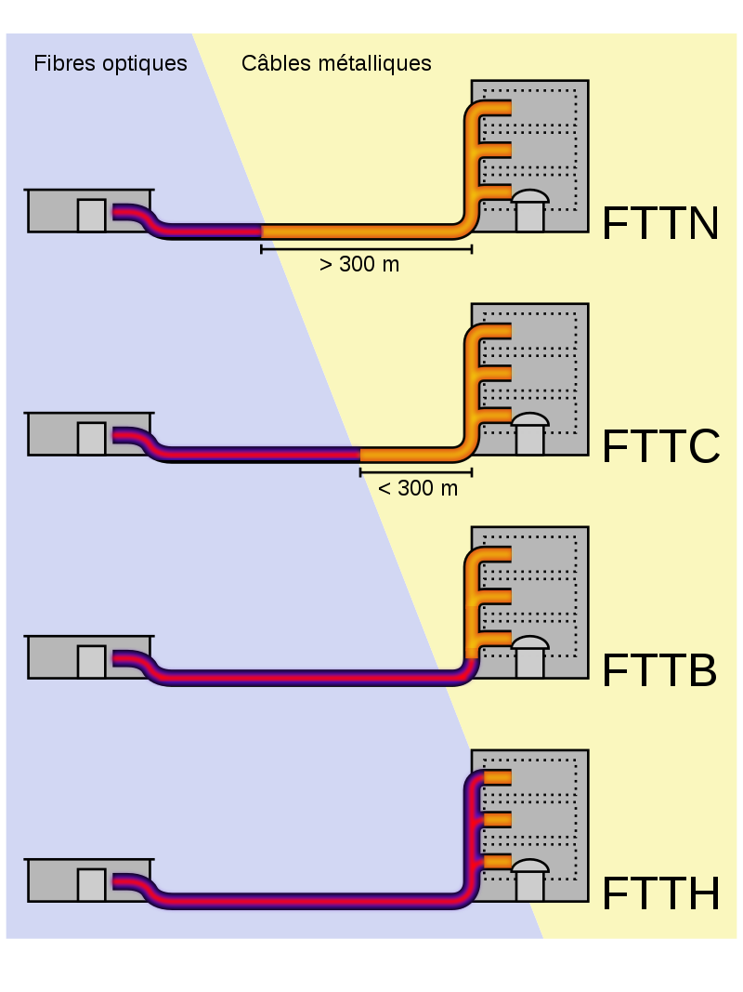
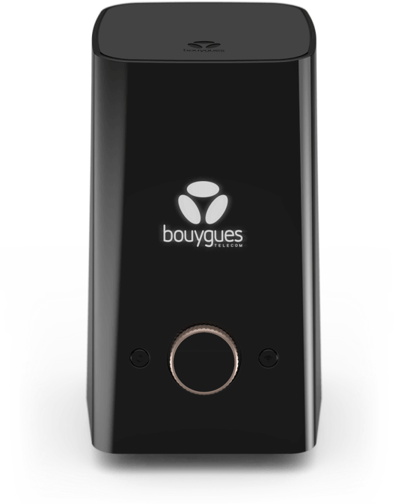
FTTH, Internet access at home
Fiber networks to deliver internat at the Home
Several systems were tested depending on deployment constraints
Fiber To The Home (FTTH)
For the history, systems offering the last hop based on coaxial cable or sometimes even copper line
Fiber To The Last amplifier (FTTLa) / FTTN (Fiber To The Neighborhood)
Fiber To The … Node / Curb / … (variable according to distance)
Fiber To The Building (FTTB)
Some rate limitations on the last hop, however much more than xDSL
An optical fibre network anyways underneath
Characteristics of the network
Optical fibre core
PON architecture for the network
End connection on an operator box

Slide 16

FTTH passive network architecture
Colonne
montante
PBO
PTO
PTO
PMI = Point de Mutualisation Immeuble
PME = Point de Mutualisation Extérieur
PBO = Point de Branchement Optique
PTO = Point de Terminaison Optique
NRO
Colonne
rampante
Tête de
câble
PBO
PD
NRO = Nœud de Raccordement Optique
PD = Point de Distribution
PA = Point de Adduction
PMI
PME
PA
PA
Périmètre de l’opérateur de mutualisation
Périmètre de l’opérateur commercial
Immeuble ou zone mutualisée
NRO
Logement
Point de
Branchement
Optique (PBO)
Tête de
câble
Point de
Distribution (PD)
Point
d’adduction (PA)
Point de
Mutualisation (PM)
Point de
Terminaison
Optique (PTO)
Colonne montante
ou
Colonne rampante
Transport *
Distribution
Adduction
Branchement

Slide 17
Network in high density areas Single fibre mutualized
Information :
Free Infrastructure
Orange
Bouygues Telecom
SFR
Coupler
PoP
Point of Presence for an operator
1 fibre par logement partagée entre ensemble des OC
Shared fibre : Bouygues Telecom, Orange, FREE et SFR
Operator CO
Mutualisation point
PoP

PoP

PoP


Brassage
PoP
OLT
Horizontal : 4 networks
Vertical : monofibre mutualised

Slide 18
Network in medium density areas Single fibre mutualised
1
Cas 1: PM < 1000 lignes
Offre de raccordement distant doit être proposée par l’OI raccordant les logements au PM.
Le Point de Raccordement Distant Mutualisé (PRDM) doit regrouper au 1000 lignes.
L’OI propose aux OC des liens entre le PRDM et les PM.
PoP
Les NRO des OC
PM
PM
PM
PM
PRDM

PoP

PoP


PM
Cas 2 : PM > 1000 lignes
L’OI n’a pas l’obligation de proposée une offre de raccordement distant.
Le PM doit contenir au moins 1000 lignes.
PoP
OLT
1 fibre par logement partagée entre ensemble des OC
2
Horizontal : 4 déploiements
Vertical : monofibre mutualisé

Slide 19
FTTH - PON vs P2P access
Splitters 1 to n
Uplink ethernet (shared)
Shared fibre
PON :
1 port = 1 fibre = 64/128/256 customers
P2P :
1 port = 1 or 2 fibres = 1 customer
Dedicated fibre

Slide 20
FTTH - PON vs P2P upstream
Uplink ethernet partagé
Fibre partagée
PON :
Upstream : x flux unicasts
P2P :
1 seul flux up et down
Fibre(s) dédiée

Slide 21
FTTH - PON vs P2P downstream
Uplink ethernet partagé
ONT
ONT
ONT
Fibre partagée
ONT
PON :
downstream : 1 seul flux chiffré
P2P :
1 seul flux up et down
Fibre(s) dédiée

Slide 22
PON Tree elements
amont
ONT : Optical Network Terminaison
ONU : Optical Network UNIT
1 ONT is a mono user ONU
ODN : Optical Distribution Network / PON tree
Olt : Optical Line Termination
aval

Slide 23
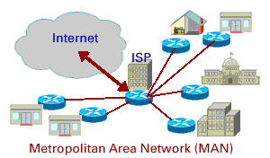
PON Variations
A metropolitan network architecture
Corresponds to levels 1-2 in the OSI network architecture
Developed for high rate internet networks
Supports usually both IP and ATM (secondary)
An architecture that evolved
Several solutions were developed
 |  | Rate (downlink) | Rate (uplink) | reference | Comment
B-PON | Broadband-PON | 1 Gbps | 622 Mbps | ITU-G.983
A-PON | ATM-PON |  |  |  | Almost not used
E-PON | Ethernet-PON | 1 Gbps | 1 Gbps | IEEE 802.3ah | Based on Ethernet
G-PON | Gigabit-PON | 2 Gbps | 2 Gbps | ITU-G.984 | To replace B-PON No full backward compatibility however Supports various protocols

Slide 24
APON / BPON
APON : ATM PON - 1999
BPON : Broadband PON / includes APON
Based on G.983 series
Rates :
155/622 mbps down / 155mbps en up (APON)
1,2 Gbps down / 622mbps en UP (BPON)
Wavelength APON :
Upstream : 1260-1360 nm
Downstream : 1480- 1580 nm (1 fibre) 1260-1360 (2 fibres)
G983.1
G983.2
G983.3
G983.4
G983.5

Slide 25
GPON
Gigabit PON
Basé sur la famille de normes G.984
TDM
Débit :
Downstream 2488,32
upstream 1244,16 (max 2488,32)
Longueurs d’onde :
1310 nm (upstream)
1490 nm (downstream)
Note : diplex-monofibre
(mode bifibre prévu par la norme)
G984.1 - General characteristics
G983.2 - physical media dependent (PMD) layer specification
G983.3 - Transmission convergence layer specification
G983.4 / G988 - ONT management and control interface specification
G983.5 - Enhancement band

Slide 26
XG(S)PON
XGPON
G987.1 - General requirements
G987.2 - Physical media dependent (PMD) layer specification
G987.3 - Transmission convergence (TC) layer specification
XGSPON
G9807.1 - 10-Gigabit-capable symmetric passive optical network (XGS-PON)
G9807.2 - Reach extension
X (Symetric) Gigabit PON
Basé sur les familles de normes
G.987 (XG)
G.9807 (XGS)
2,5/10G (XGPON)
10Gbps bidirectionnel (XGSPON)
- 1277 nm upstream
- 1570 nm downstream

Slide 27
NGPON2
G989.1 : Réseaux optiques passifs de 40 gigabits (NG-PON2): Caractéristiques générales
G989.2 : Réseaux optiques passifs de 40 gigabits - version 2 (NG-PON2) : Spécification de la couche dépendante du support physique (PMD)
G989.3 : Réseaux optiques passifs de 40 gigabits (NG-PON2): Spécification de la couche de convergence de transmission
Next Generation PON 2
Basé sur la famille de normes G.989
TWDM
Débits :
4x10G (Opt. 8x10G)
Longueur d’onde :
Downstream 1596-1603 nm
Upstream :
- Wideband option 1524-1544 nm
- Reduced band option 1528-1540 nm
- Narrow band option 1532-1540 nm

Slide 28
25GPON
Basé sur la norme IEEE 802.3ca et une extension du XGS-PON pour la couche de convergence
25GSPON servirait d’intermédiaire entre le 10GPON et le 50GPON
25G symmetric PON multi-source agreement (25GS-PON MSA) ➔ 10+ constructeurs
Débits :
25/10 Gbps
25/25 Gbps
Longueurs d’onde :
Prise en compte de plusieurs options de longueur d’onde upstream
UW0 : 1270nm – collision avec le XGSPON
UW1 : 1310nm – collision avec le GPON
UW3 : 1286nm – pas de collision ➔ permet la coexistence GPON / XGSPON / 25GPON
En downstream :
1358nm
Notes:
GAP technologique moins important par rapport au 50 GPON
Differences
Rate : 24,8832 Gbit/s
Structure de frame de 125 us conservée
Blocs de 40 octets
+1 Alloc-IDs +1 ONU-Ids pour les 25G ONUs
LDPC FEC
Rate : 24,8832 Gbit/s
Source :
https://www.25gspon-msa.org/
25GS-PON-Specification-V2.0

Slide 29
50GPON
G.9804.1 – requirements
G.9804.2 - common transmission convergence layer specification
G.9804.3 - physical media dependent (PMD) layer specification
G.Hsp.50gpmd
Higher Speed Passive optical networks
Basé sur la famille de normes G.9804
Débits :
50/50 Gbps
50/25 Gbps – 50/12,5 Gbps – 50/10 Gbps
Longueurs d’onde :
Downstream : 1340– 1344 nm
Upstream : compatibilité avec 10gbps and 25gbps +
1290 nm~1310nm : ne peut coexister avec le GPON US (1310 nm)
Ou
1270~1280 nm : ne peut coexister avec le 10GPON US (1270 nm)
ou
~1286 nm : coexistence possible avec GPON et XGSPON
Notes:
Nécessite un gap technologie, notamment au niveau des composants, bien plus important

Slide 30
100G PON
https://www.nokia.com/about-us/news/releases/2021/02/02/nokia-and-vodafone-showcase-record-breaking-100-gigabit-fiber-broadband/
Tests réalisés (nokia + vodafone) – annoncé en février 2021
1 seul lambda
Téléportation virtuelle ?
3D holographique ?
5G/6G

Slide 31
EPON/10GEPON/50GEPON
1G EPON - 802.3ah (2004)
1/1 Gbps
10G EPON - 802.3av (2009)
10/1 Gbps
10/10 Gbps
freebox delta (commercial : 8Gbps/700Mbps)
50G EPON - 802.3ca (2020)
25/10 Gbps
25/25 Gbps
50/10 Gbps
50/25 Gbps
50/50 Gbps

Slide 32
Etat des lieux
Solution proposée par certains constructeurs (Nokia, DZS, etc.)
100GPON / 200GPON / TERAPON
100G
Solution coûteuse, peu utilisée
NGPON-2
G.989.x
50G
25G/50G-EPON
802.ca
50GPON
G9804.x
25G
25GPON
MSA
Majoritairement déployé dans le monde
Tous les constructeurs travaillent dessus
10G
10G-EPON
802.av
XGSPON G.9807.x
IEEE
Solution choisie par la plupart des opérateurs
IUT-T
Solutions choisies par certains opérateurs
1G
GPON
G.984.x
EPON
802.ah
Hybride
TbD
2003
2004
2009
2013
2016
2020
2021
202x / 203x
32

Slide 33
PON Characteristics (1/2)
Passive Optical Network (PON)
A network architecture based
Optical fibre
Sharing resource by using massively couplers (possibility to have a 2-level coupling structure), still possibility for passive P2P (see FTTO later on)
A connection between
an Optical Line Termination (OLT) that gives access to network and service
an Optical Network Termination (ONT) that is the connection point for the end user (Optical Network Unit in the case of FTTB/FTTLa)
Optical fibre characteristics
Single-mode Fibre (the usual case) with typically G657 in Europe
Bi-directional communication on the fibre (downlink 1490 nm, uplink 1310 nm)
Couplers to access the network resource
TDMA multiplexing of users in both directions of transmission

Slide 34
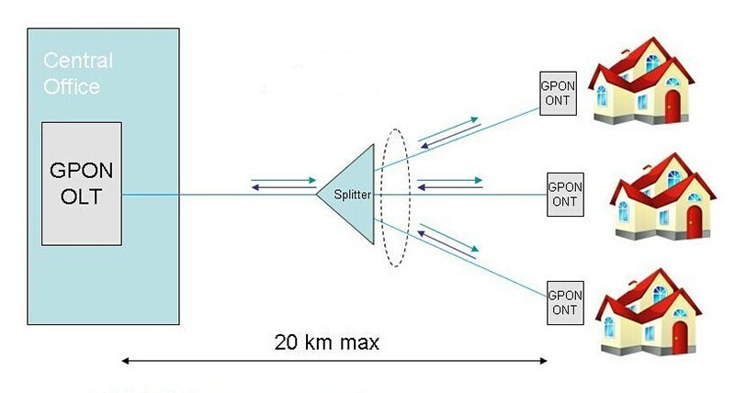
PON Characteristics (2/2)
Security
A requirement especially on a shared network
End to end AES128 coding
Coupling limits
Resource sharing on FTTH is a compromise between
Optimizing the investment over an optical fibre network
Providing significant resource to the end users
A common value for fibre coupling is 1/64, it however can reach 1/128 in some places.
Limits
Distance is limited to ~20 km max mainly due to
Laser beam used
Massive use of couplers/splitters on the line

Slide 35
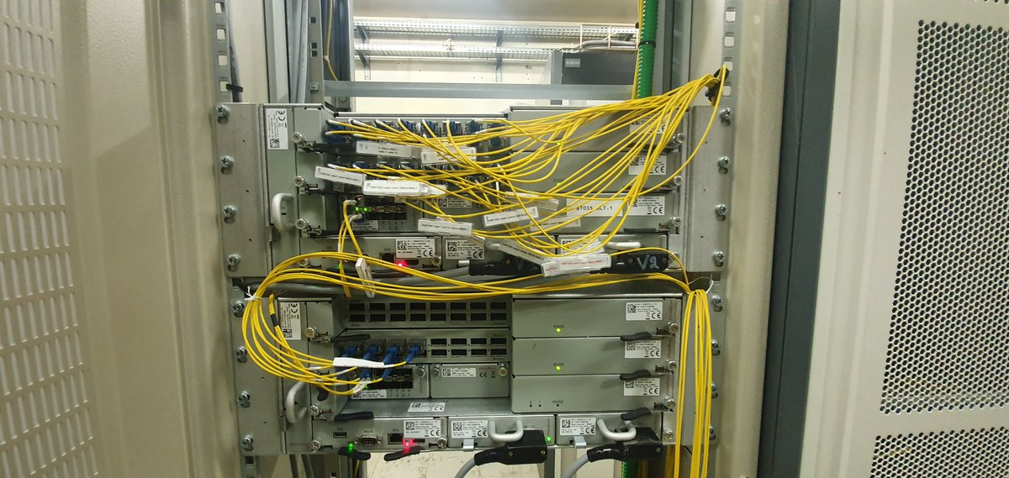
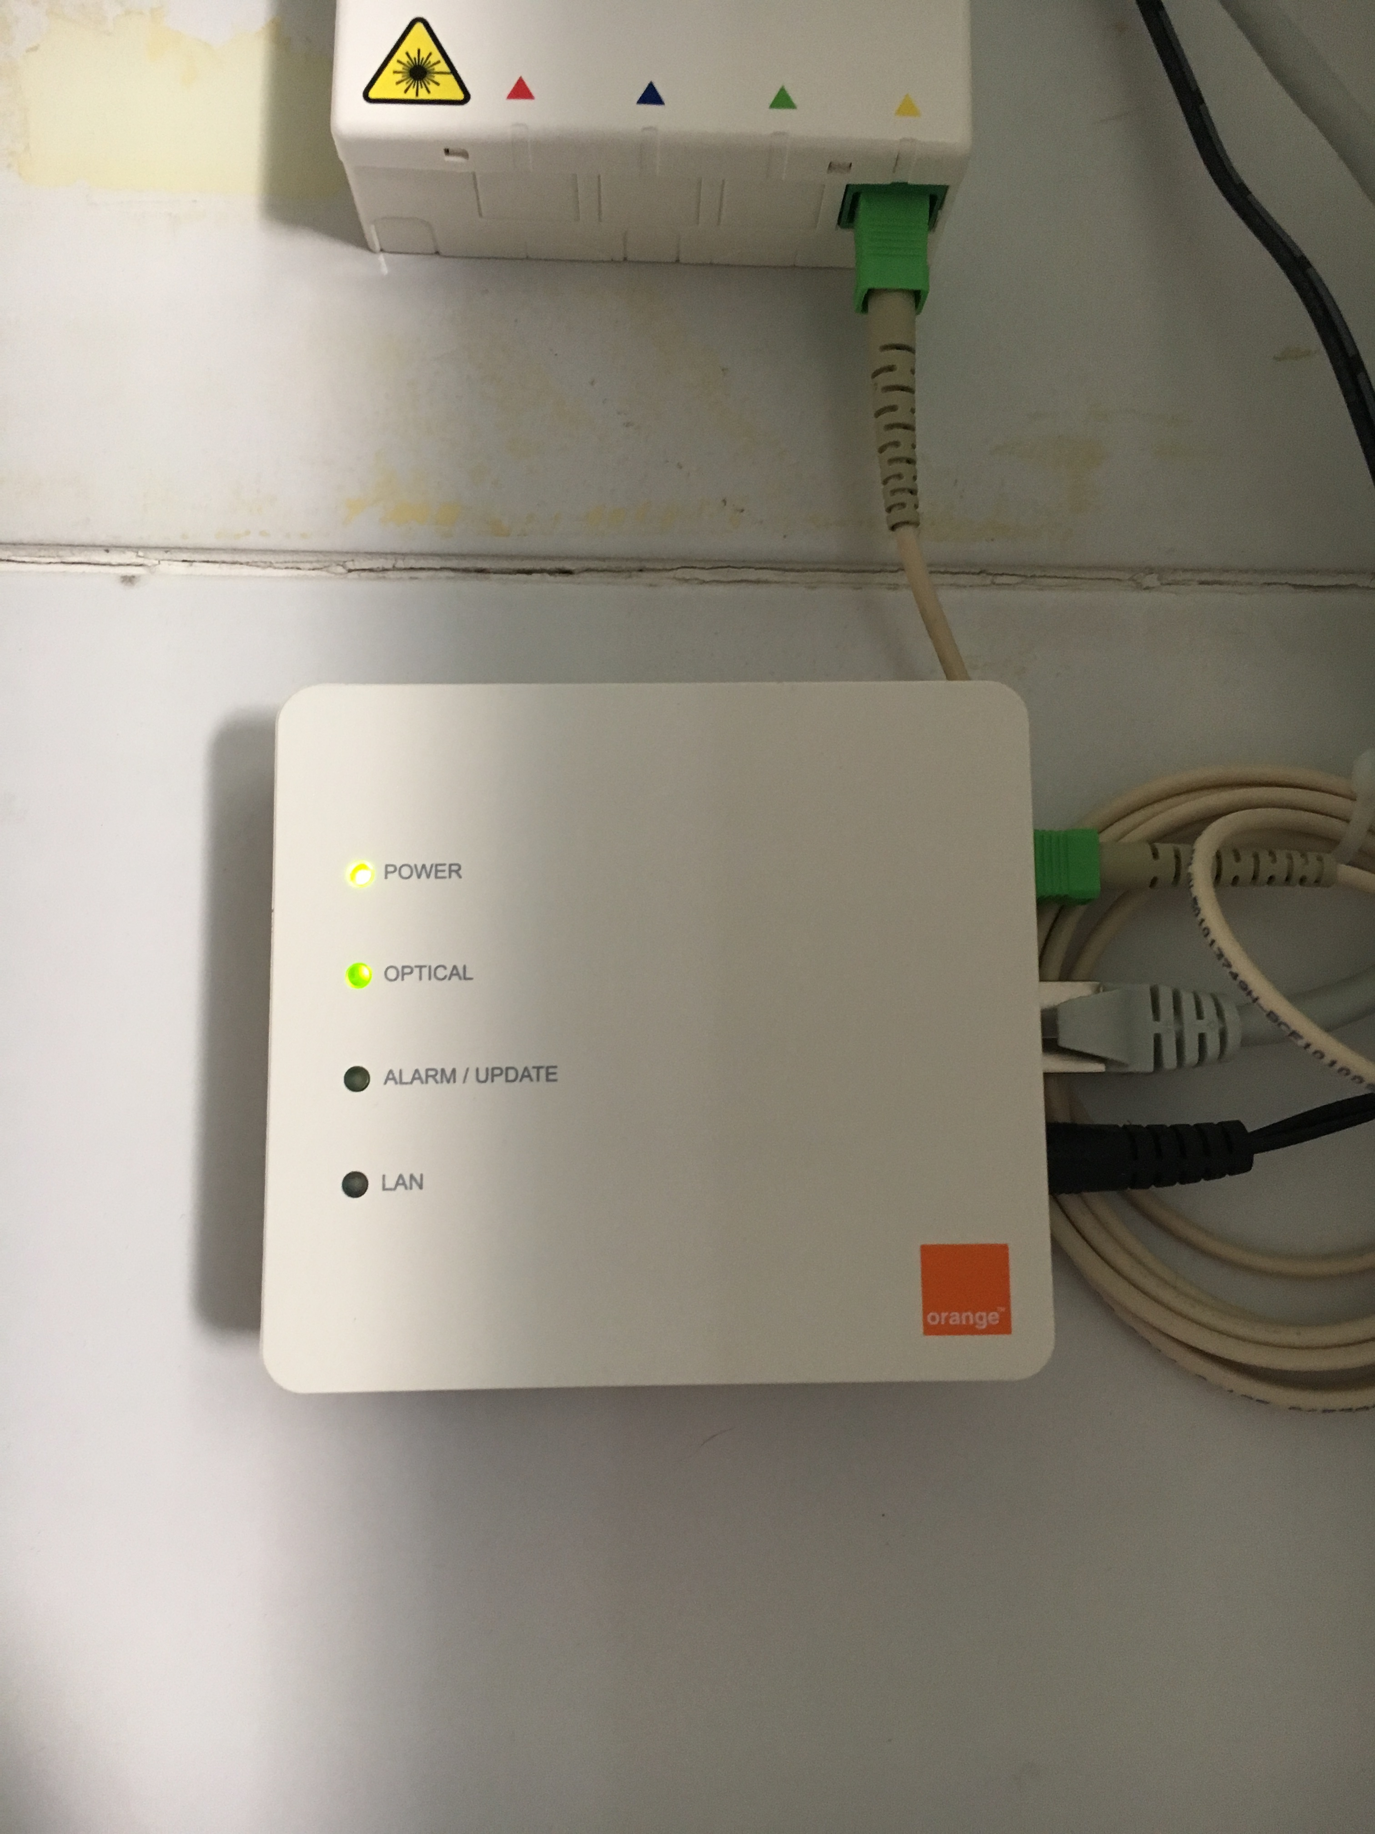
PON Components
Passive Optical Network (PON)
A network architecture based
Optical fibre
Sharing resource by using massively couplers (possibility to have a 2-level coupling structure)
A connection between
an Optical Line Termination (OLT) that gives access to network and service
an Optical Network Termination (ONT) that is the connection point for the end user (Optical Network Unit in the case of FTTB/FTTLa)
Optical fibre characteristics
Single-mode Fibre (the usual case) with typically G657 in Europe
Bi-directional communication on the fibre
Couplers to access the network resource

Slide 36
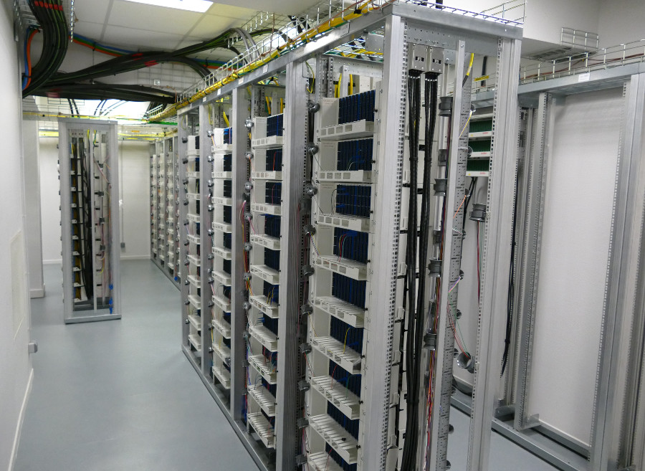
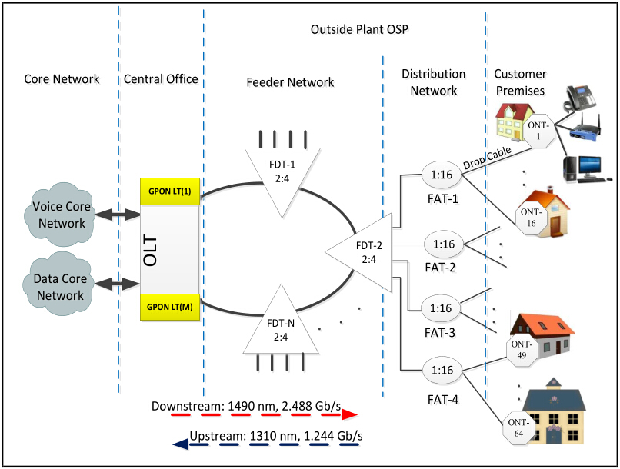
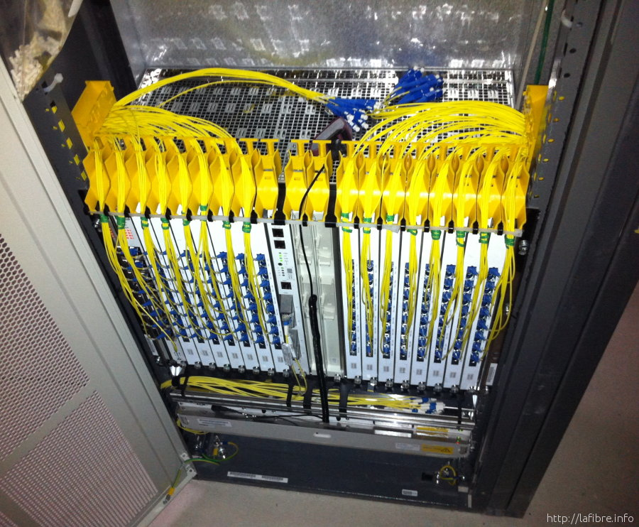
Central Office (NRO)
An anchoring site
A massive number of end-users connected (several dozen of thousand users)
Optical Line Terminal (OLT)
OLT, similar to DSLAM in the xDSL terminology
A set of end-users connection point to transportation network
Main characteristic :
Entry point to optical network
Connected to routers
Connected to backbone
Include passive splitters
In French…
NRA (Noeud de Racco. Abonné) : xDSL
NRO (Noeud de Racco Optique) : Fibre

Slide 37
Central Office / Network sharing
Option 1 : Operators have their own OLT
The main option : in France most of the Central Office were deployed by Orange and SFR (co construction operations)
Competition Operators have identified fibres connected to their OLTs through local operator. The traffic is then sent to the end-user operator backbone.
Option 2 : Active Backhaul
The typical option for low density areas where deployment is not made by operators, but local authorities.
Happens in some cases for special areas.
The traffic is routed by the local operator to the end user’s operator connection point

Slide 38
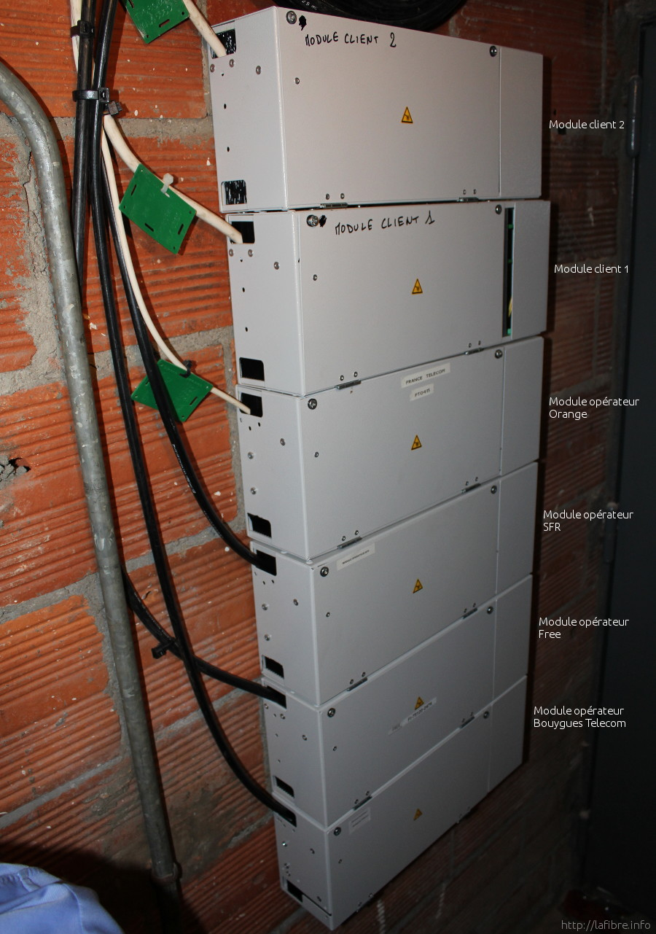
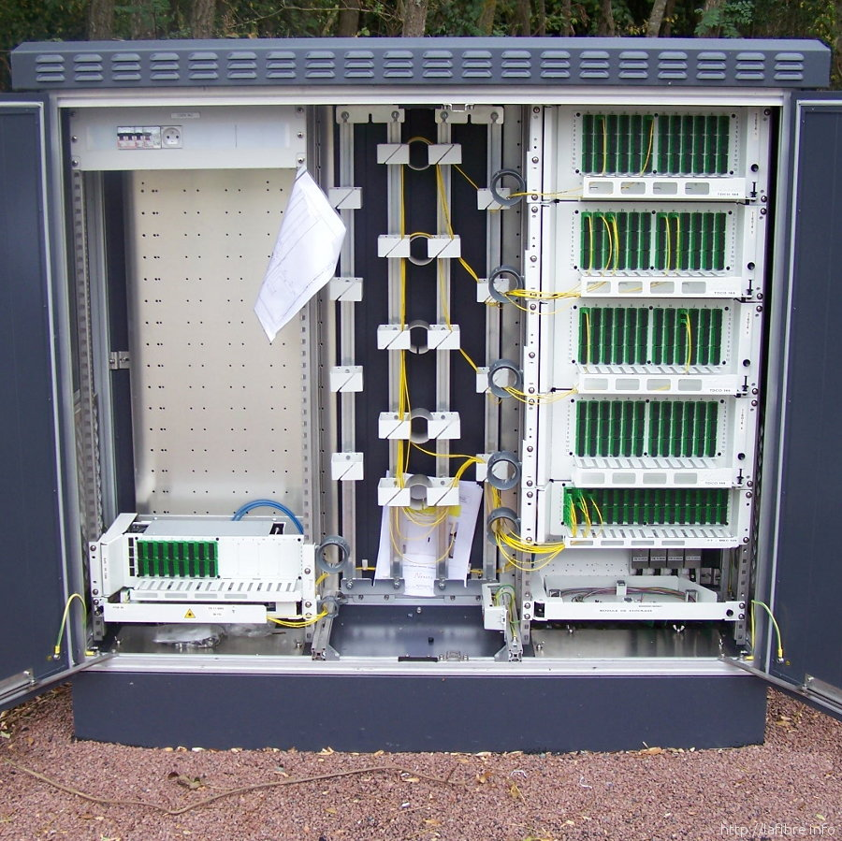
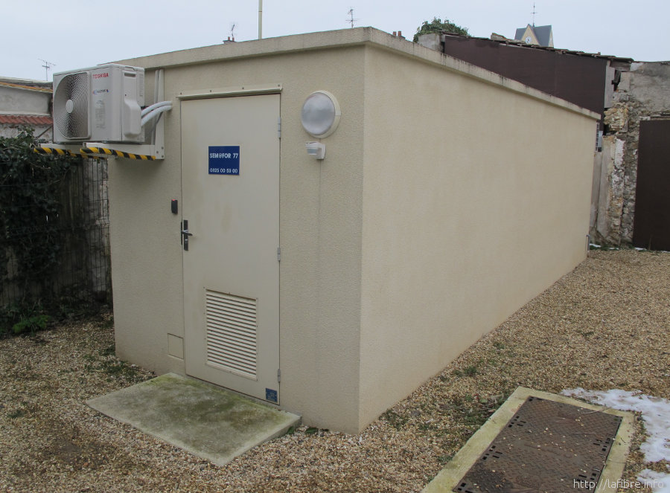
Mutualisation points (PM)
Equipment that allows mutualisation of Fibre
The merging point of end-users connection
Several types of mutualisation points
Indoor for the case of large buildings
Outdoor
when houses are connected
for mutualisation over a full area/district

Slide 39
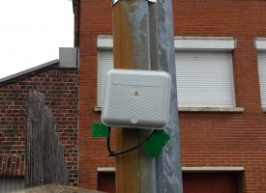
Middle connection points (PBO)
Intermediate points between site and end-users
The merging point of end-users connections
Typically used in residential areas where multiple connections cannot be done within a building
Characteristics
A box that allows a set of connections (usually up to 12)
Access to a cable that is connected to a mutualisation point
Usually no couplers in such boxes although not forbidden as a rule

Slide 40
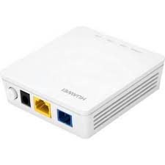
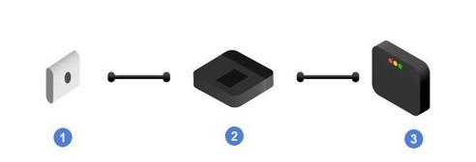
End connection points (ONT)
Optical Network Termination (ONT)
The end point for end-users connections
The final optical point : afterwards connection is based on another medium, usually ethernet, could be coaxial (FTTLa)
Characteristics
Adaptation of transmission medium : optical to electrical
Similar to a SFP, likely to be replaced by SFP ultimately
The main difference is the power to supply to ONT
Some security concerns with regards to ONT
could be hacked if not located in the final office or appartement
whereas SFP is by definition located in the delivery point

Slide 41
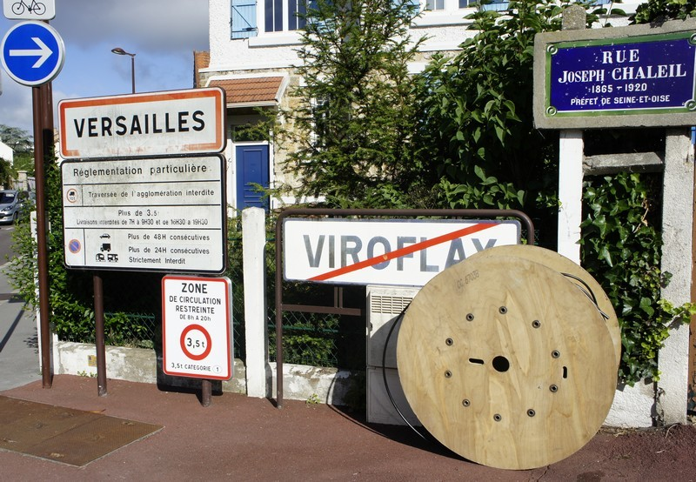
How does fibre comes to home ?
The story of an installation
Network Cable installed
Using when possible Orange ducts infrastructure
Digging when required
Installing a cable in every street from the collecting point
An article in French @ https://www.01net.com/actualites/comment-la-fibre-optique-arrive-jusqu-a-chez-vous-1300062.html

Slide 42
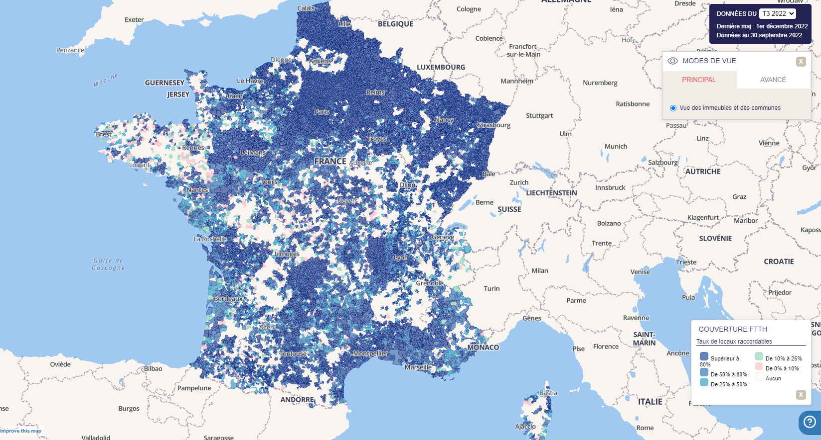
FTTH in France (1/2)
State of the art
Most of the country can be connected throughout multiple combination of infrastructures
4 main operators for end-users
Multiple local operators for low density areas
A ruled market
Being an operator comes with commitment to deploy network (coverage, technology, rate…)
On shared areas, operator commit to provide access to competition in a fair manner
Some resource on @ https://cartefibre.arcep.fr/index.html?lng=3&lat=46.57692011118078&zoom=6.491853096329674&mode=normal&legende=true&filter=true&trimestre=2022T3

Slide 43
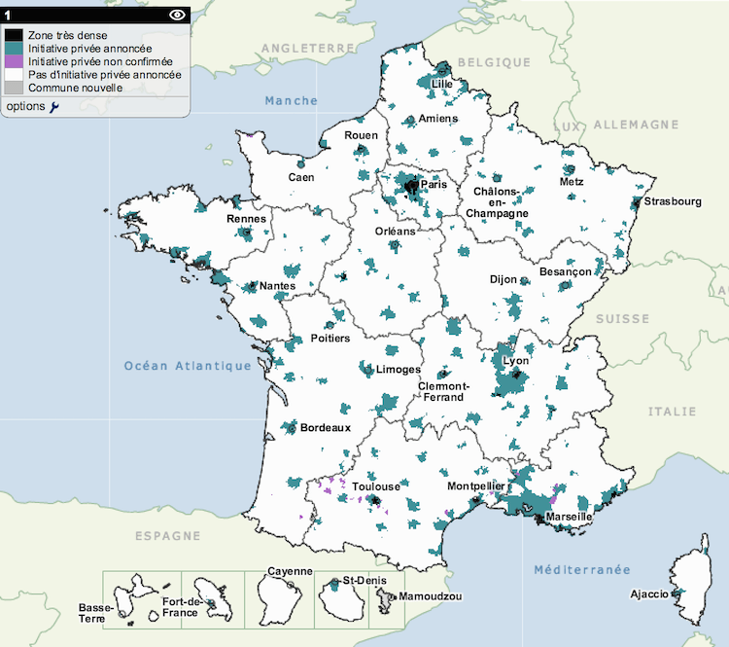
FTTH in France (2/2) : various areas
High density areas
All operators have infrastructure
Sharing verticality of users buildings
“AMII”/”AMEL” areas
One operator have infrastructure
Commitment for coverage and access to competition
Infrastructure compatible with competition rules
Capability to host OLT from other operators for their user’s backhaul
Competition operators are renting fibres
“RIP”, the “DSP” areas
Low density areas where RoI is difficult
Local administration delegates local operator to deploy infra
Main Operators are dealing with local operator to backhaul customers
Either by adding an OLT in the Central Office
Or by negotiating active backhaul
Notes:
https://www.maire-info.com/numerique/ftth-rip-amii...-le-lexique-pour-(enfin)-tout-comprendre-aux-enjeux-du-tres-haut-debit-article-23559

Slide 44
FTTH zones in France
High density area
ZTD
7,9 M places
106 Cities
(148 with districts)
Medium density zones
33,6 M places – 34 700 cities
Private zones
« AMII »
15,9 M places
4 300 cities
63% houses | 37% Flats
Private zones
« AMEL »
1,5 M places
2 600 Communes
95% houses | 5% flats
Public zones
« RIP »
16,2 M places
27 800 cities
95% houses | 5% flats
High density zones
81%
6,7 M places
Low density zones
15%
1,2 M places
Orange
12,9 Mloc.
(81%)
SFR
3 Mloc.
(19%)
Orange
0,4 Mloc.
(27%)
SFR
0,8 Mloc.
(53%)
Altitude
& TDF
0,3 Mloc.
(20%)
Collectivité Territoriales
Via Délégataires de Services Publics :
Axione, Altitude, SFR Coll., Orange Coll., TDF, SIEA, autres régies
Spec. zones
4%
0,3 M places
ZSP = Zone Spécifique
AMEL = Appel à Manifestation d’Engagement Local
AMII = Appel à Manifestation d’Intention d’Investissement
RIP = Réseaux d’Initiative Publique
Notes:
Les zones conventionnées (AMII, AMEL)
Les opérateurs privés s’engagent à déployer la fibre optique, ils signent des conventions avec l’état et les collectivités territoriales.
Des obligations de couverture sont définies, par exemple 92% des Locaux Raccordables en fin 2020 en AMII.
Ces zones concernent 55% de la population et représentent un investissement de 6 à 7 milliards d’euros.
Les zones non conventionnées (RIP)
En dehors des zones conventionnées, les collectivités territoriales déploient des réseaux d’initiative publique (RIP).
Ces zones concernent 45% de la population et représentent un investissement de 13 à 14 milliards d’euros.
AMII ➔ initiatives privées
AMEL ➔ initiatives publiques (Appel d’offre)
RIP ➔ zones non rentables pour OI, à la charge de collectivités / DSP

Slide 45
FTTA, from Fiber To The Antenna to Fiber To The Access

Slide 46
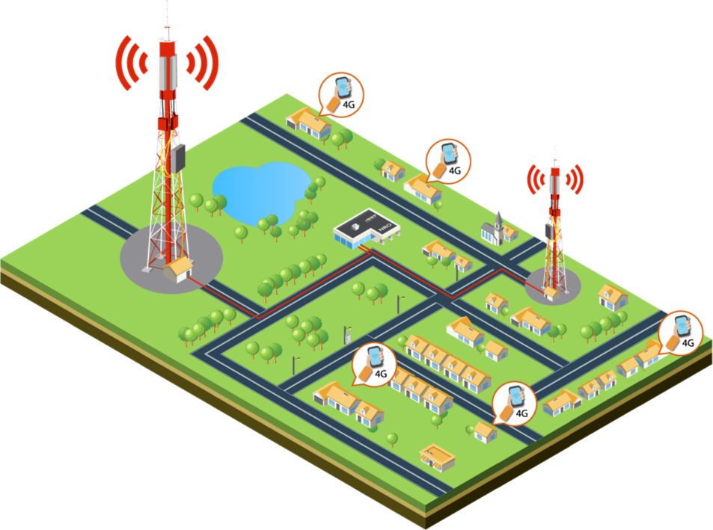
FTTA (Antenna or Access?)
Initially
FTTA is defined is an optical fibre network to reach mobile networks radio sites
The need
Increasing rate need for 4G (even more with 5G)
Latency requirement for 5G services (few ms)
Security and reliability (even more than for end-user’s internet cx)
The existing solutions
Optical fibre for transportation
Backhaul sometimes with optical fibre but wireless beams are used
FTTA first targets radio networks
Radio site are first priority in terms of requirement
To have a return on investment, FTTA is also used to collect traffic from other services, including FTTH users in some places, FTTO, …

Slide 47

Fronthaul or Backhaul principles
Radio site architecture principle
Antenna(s)
Remote Radio Head (RRH)
BaseBand Unit (BBU)
+ energy…
Two solutions for collecting radio
Backhaul
Autonomous radio sites
Fronthaul
Antenna and RRU co-located
BBU as part of the anchoring sites
Connection between RRU and BBU on a dedicated optical fibre per connection usually based on eCPRI protocol
RRH
BBU
network
RRH
BBU
Rou-ter
network
RRH
BBU
Rou-ter

Slide 48
Fronthaul or Backhaul strategy
Interest of the solution
Part of a trend for network virtualisation
Reduces the need for routing and multiplexing technologies
Focusses site development on a set of datacenters (with the constraint of latency)
Realism plays against fronthaul
Criticity of optical fibre ressources in dense areas
Ducts are full
Buildings owner are reluctant to cables installation (although interested in renting their roof
Multiplication of large anchoring sites
(let say… datacenters) in a period where operators are challenged by public on their footprint
difficulty to identify appropriate sites in dense areas
Challenges include
the synchronization of the network
2G, 3G
RRH
BBU
4G
RRH
BBU
Rou-ter
5G
RRH
BBU
2G, 3G
RRH
BBU
4G
RRH
BBU
Rou-ter
5G
RRH
BBU

Slide 49
FTTA basic needs for operators
Specific requirements
Large coverage network (4G/5G radio sites will be numerous)
FTTH density is not required and would have a high cost
Avoid couplers
Adaptation to urban areas
A ideal solution (loops, see later on)
Specific solution to reach areas around
Railways
Special zones (commercial zones, airports…)
Infrastructures (ducts) saturation
Local rules to dig
Adaptation to Countryside
Loops are difficult to deploy
Specific solution to reach areas around
Motorways
Private properties (fields, properties aside roads…)
Topography difficulties

Slide 50
FTTA Architecture basics
A network architecture based
Optical fibre loops
Fibre can be shared by logical means, no coupling
Use of routers
Use of splitters and switches for some connection
A connection between
The equipment to connect one side
Radio site
FTTO customer
FTTH anchoring site (NRO…)
The anchoring site (see next slide for more details)
Optical fibre characteristics
Single-mode Fibre (the usual case) with typically G657 in Europe
Bi-directional communication on the fibre (downlink 1490 nm, uplink 1310 nm)

Slide 51
FTTA topology/characteristics
The usual loop based topology in urban areas
Access to the network always offer two ways to reach anchor site
Depending on the requirement such possibility is used or not (typically it is for radio sites or FTTH zones, not for FTTO unless special offer)
The material
Optical fibre typically G657 (for dense areas)
288 fo for transportation level
72 fo for distribution or pendulars
24 for sites abductions

Slide 52
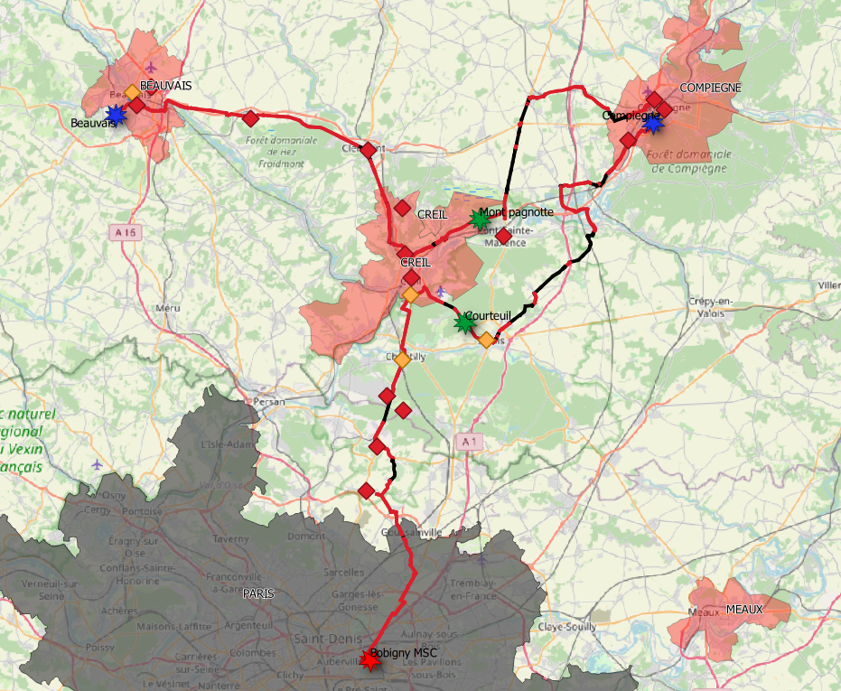
FTTA topology/characteristics
Logical loops topology for country side
Loops would be costful and useless on long haul connections
No physical loops however, keep the loop mind
Logical loop by using IP routing
Physical loop by using long haul connections for transportation network (constraints however on latency)
Importance of sizing and functional split of the anchoring points
Similar material than for loops
NRA
MO
NRA
SO
MO
Régénération
Lien inter UU
SO
Amplification
DN
CO

Slide 53
FTTA architecture in layers
Urban area
FTTA, optical fibre and anchoring sites into 3 layers
CO
MO
CO
MO
SO
FTTA : Collecting sites
Network elements connection on loops and intercity links, typically :
Mobile network (radio sites, Merging points)
NRA/O, FTTO
Other connections, hosting capability
MO
MO
Urban area
CO
CO
MO
FTTA : Transportation layer
Network routing between anchors
Interloops links and loops
Intercity (inc. amplification)
Dark fiber access
SO
MO
MO
MO
CO
FTTA : Backbone / Core
Trafic routing within the network
CO
SO
MO

Slide 54
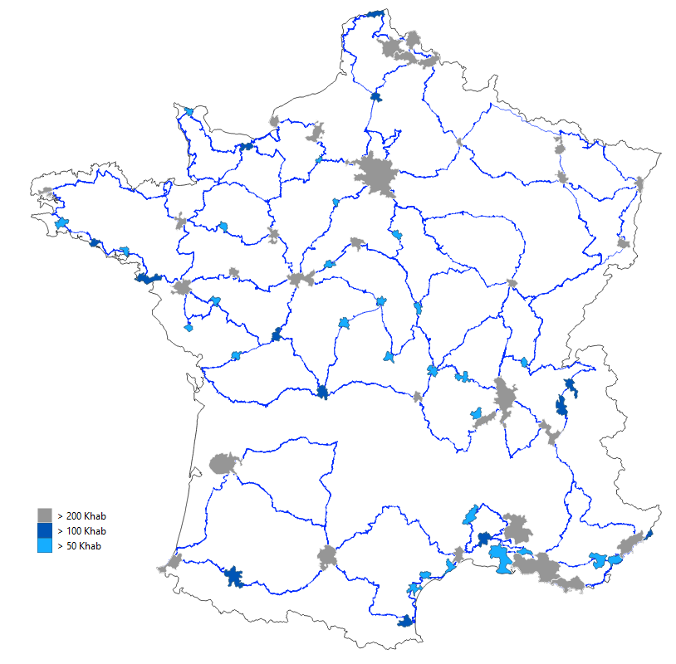
A national coverage example
A combination of loops and links
A set of loops in the main cities
A set of intercity links to connect them all
The quality of FTTA design
Setting the correct number of anchoring points
Covering the areas with high potential of sites to connect
Offering the possibility to create loops between the cities to secure the connections even though some links would be broken
Providing opportunities for future extension by
Adding loops in dedicated areas (cities not addressed at first)
Adding links to make the network even more dense
Connecting other types of network on interconnection gates

Slide 55
FTTA anchoring sites
Small Office
Also called ILA for some operators
Main operation is to amplify the signal over long haul link (no SO on dense areas)
Metropolitan Offices
Sites mainly focus on collection and transportation requirement
Mainly located on loops of dense areas (inc. cities and places where collecting traffic is required)
Embed
Collecting equipements
WDM equipments for aggregation and transportation
Central offices
All that a MO is offering
Additionally the offer services and core network access
Highly secure sites (some are of vital importance for the overall network)
Secure by split between different and isolated parts of a building

Slide 56
Long haul connections and submarine cables

Slide 57
Long haul connections, the need
The need
Security
Latency
Solutions
P2P
Tree
Loops

Slide 58
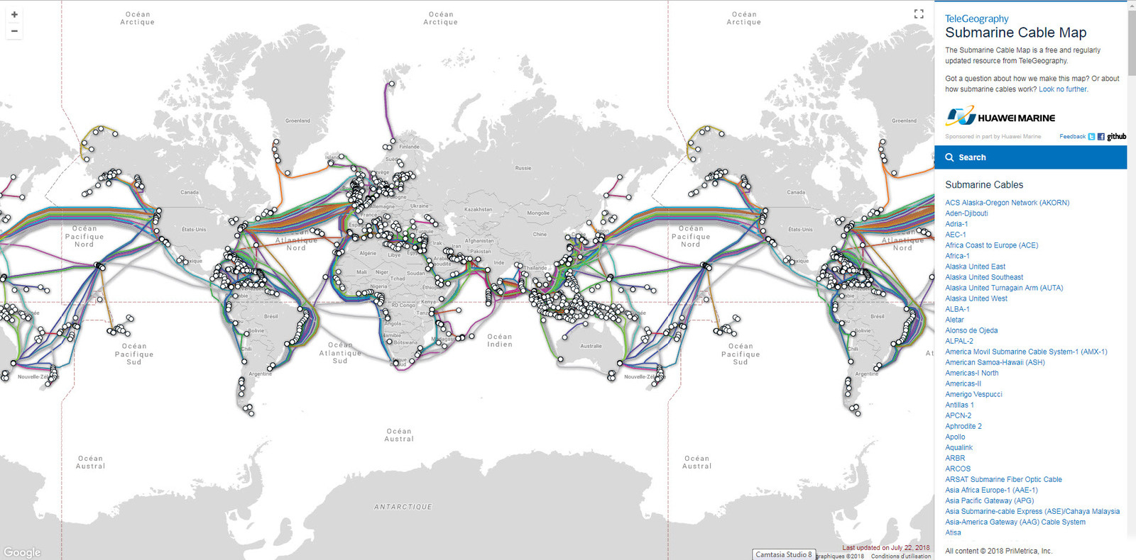
Very long haul connections
https://www.submarinecablemap.com/

Slide 59
A bit of history
The need
Mainly related to telecommunications and to connect continents
At this stage, for cost and efficiency reasons, 99% of the communications are using this type of cables
Submarine / Intercontinental cables
For power and telecommunications in three steps
Copper cables since 1850
A cable from France to UK
England to Ireland
Corsica to Algeria (Napoleon III)
Ireland to Canada (1858)
Coaxial cables since 1956
Optical fibre since 1988

Slide 60
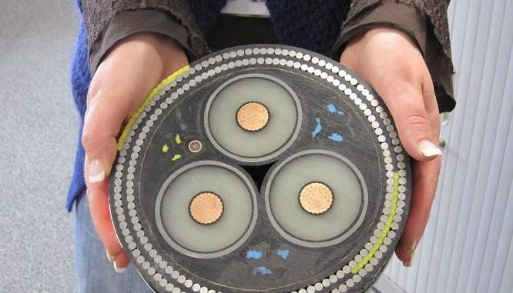
Special characteristics cables
Reliable cable
Rigidity to prevent torsion/bending
Protection to environment (animals, meteo phenomena, fishing boats…)
Power can be embedded in the cable itself
Equipments on the way
The need for amplification on the way due to the distance
Active systems to be powered
Possibility to add connections/Maintenance
For maintenance or exceptional diversion, cable can be removed from water
Typical case of Mediterranean cables getting along the coast waiting to be extended (to Corsica for instance)

Slide 61

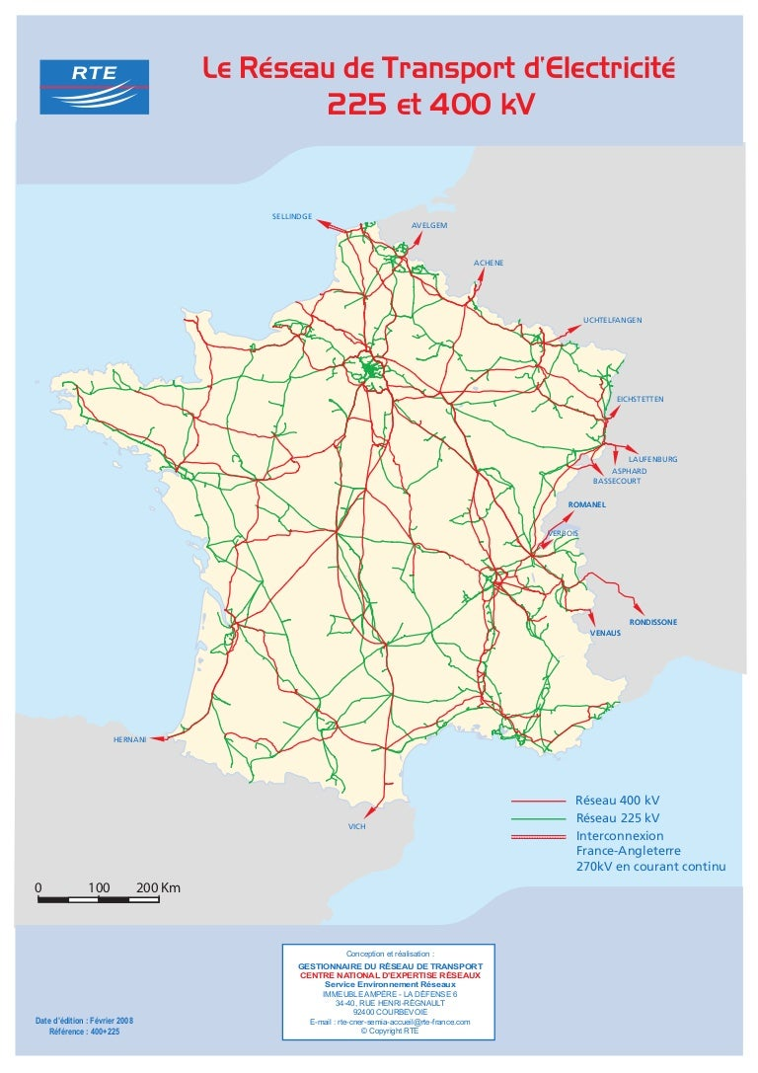

Optical fibre on top of Power Grids

Slide 62
FTTE and FTTO Services over Optical Fibre

Slide 63
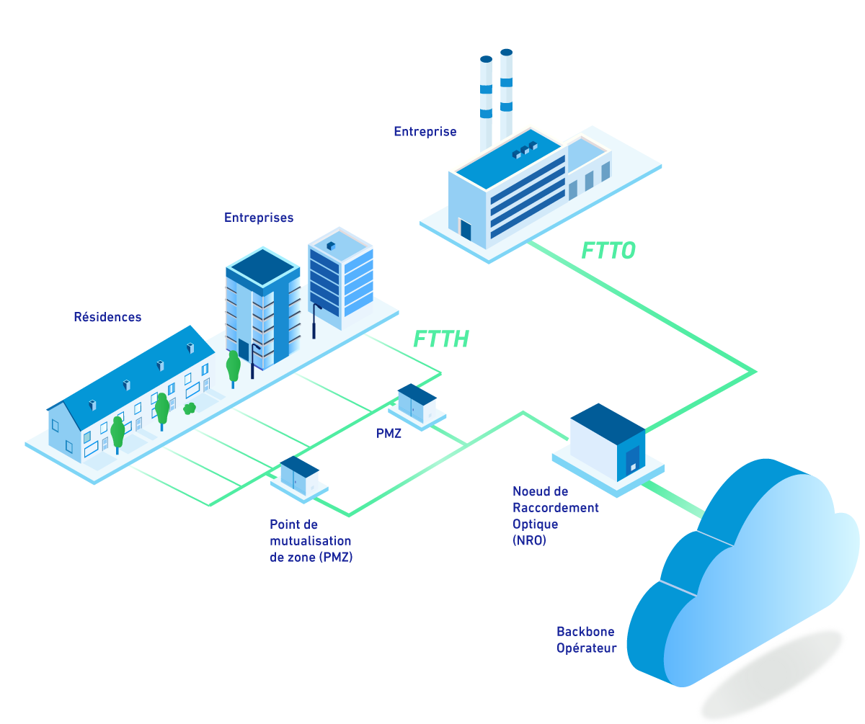
FTTO/FTTE services
The requirement
A peer to peer connection
A fibre is aligned end to end, the operator provides equipment both sides and possibly multiplexed over the distance
Services rather than network
Three solutions to offer FTTO/E
Dedicated cable to reach operator network
FTTH when coverage is compatible
FTTA when coverage is compatible
The supporting network provide specific advantages
Physical security is easy to propose on FTTA loops
FTTH offer the P2P connection and density on its coverage which means a cheap deployment

Slide 64
FTTO/FTTE coverage
An offer available where optical fibre are
A combination of
FTTH
FTTA
FTTH brings the coverage in dense areas (cities…)
FTTA has a larger coverage, however usually requires some deployment to reach the connection point
Intersection with the wholesale
Companies are willing to access the internet
They also usually have requirement for the connection to datacenters
FTTO service is possibly combined for the operators with dark fibre offers

